Slide 1
Randomized Algorithms CS648
Lecture 12
Expected duration of a randomized experiment
Part II

Slide 2
Expected duration of a random experiment
X : the r.v. for the duration of a randomized experiment.
To calculate E[X], the following approach is sometimes useful:
Partition the experiment into stages carefully.
Calculate expected duration of each stage.
Using linearity of expectation, calculate E[X].

Slide 3
Distributed Client-serveR Problem

Slide 4
ReCAP from last Lecture
First some discrete mathematics

Slide 5

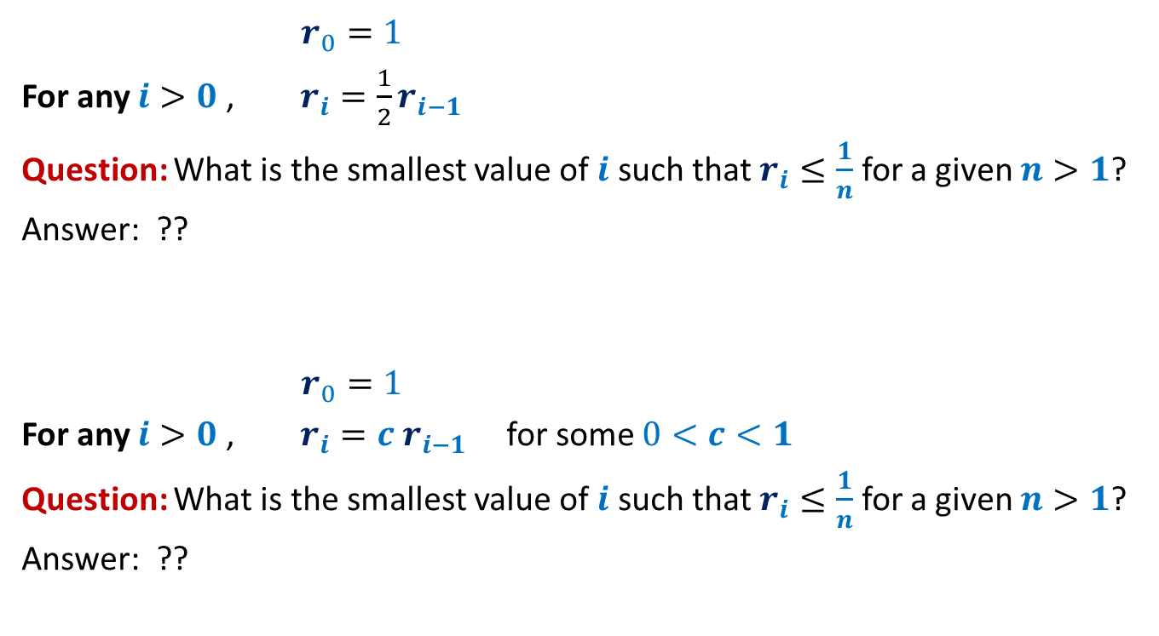

Recurrence 1
$r_{0}=1$
For any $i>0$, $r_{i}=\frac{1}{2}r_{i−1}$
Question: What is the smallest value of $i$ such that $r_{i}≤\frac{1}{n}$ for a given $n>1$?
Answer: ??
$r_{0}=1$
For any $i>0$, $r_{i}=c r_{i−1}$ for some $0<c<1$
Question: What is the smallest value of $i$ such that $r_{i}≤\frac{1}{n}$ for a given $n>1$?
Answer: ??
$$⌈\log_{2}{n}⌉$$
$$⌈\log_{\frac{1}{c}}{n}⌉$$

Slide 6
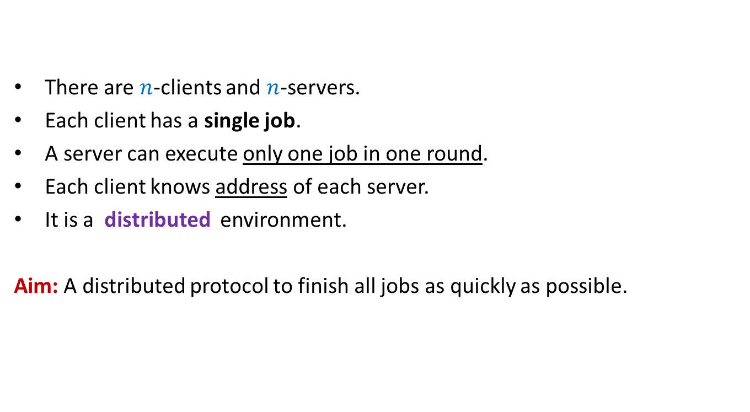
Distributed Client-Server Problem
There are $n$-clients and $n$-servers.
Each client has a single job.
A server can execute only one job in one round.
Each client knows address of each server.
It is a distributed environment.
Aim: A distributed protocol to finish all jobs as quickly as possible.

Slide 7
Distributed Client-Server problem
1
2
3
4
5
6
7
8
Clients
It can be framed as our familiar
ball-bin problem.
☺
Servers
1 2 3 4 5 6 7 8

Slide 8
Distributed Client-Server problem
1
2
3
4
5
6
7
8
Balls
Bins
1 2 3 4 5 6 7 8

Slide 9
Distributed Client-Server Problem
Randomized protocol (one round)
Each client sends a request to a server selected r.u.i.
Each server which receives one or more requests,
accepts only one request and finishes the corresponding job.
Each client, whose job is finished, leaves the system.
The remaining clients repeat the same procedure in next round.
Question: what is the expected number of rounds to finish all jobs?

Slide 10
Distributed Client-Server problem Randomized protocol
Round 1
1
2
3
4
5
6
7
8
1 2 3 4 5 6 7 8

Slide 11
Distributed Client-Server problem Randomized protocol
3
4
7
8
1 2 3 4 5 6 7 8

Slide 12
Distributed Client-Server problem Randomized protocol
Round 2
3
4
7
8
1 2 3 4 5 6 7 8

Slide 13
Distributed Client-Server problem Randomized protocol
Round 3
8
1 2 3 4 5 6 7 8

Slide 14






Distributed Client-Server problem Randomized protocol
Round 1
1
2
3
$$n−1$$
$$n$$
$Y$ : no. of balls leaving the system in round $1$.
E[$Y$] = ??
= $n−n{\left(1−\frac{1}{n}\right)}^{n}$
= $\left(1−\frac{1}{e}\right)n$
$X_{1}$: no. of balls remaining in the system after round $1$.
E[$X_{1}$] = $\frac{n}{e}$
1 2 3 … $n$-1 $n$
$$n −expected no. of empty bins$$
$$≥$$
$$≤$$

Slide 15




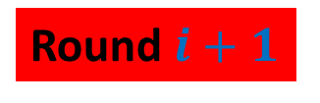
Distributed Client-Server problem Randomized protocol
Round $i+1$
1
2
$$m$$
E[$X_{1}$] = $\frac{n}{e}$
$X_{i}$: no. of balls at the end of round $i$.
E[$X_{i+1}$| $X_{i}=m$] = ??
$$m$$
1 2 … $n$-1 $n$
$$≤\frac{m}{e}$$

Slide 16

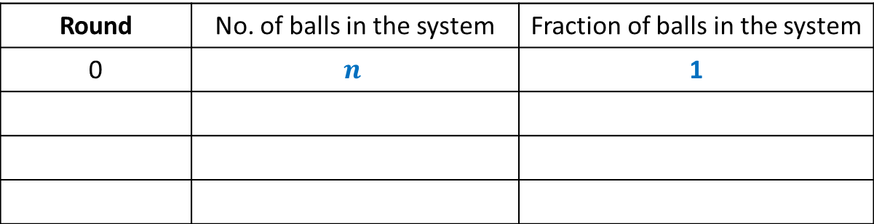
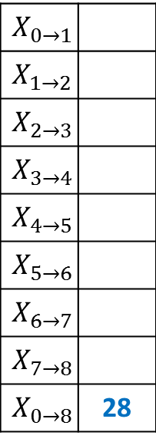

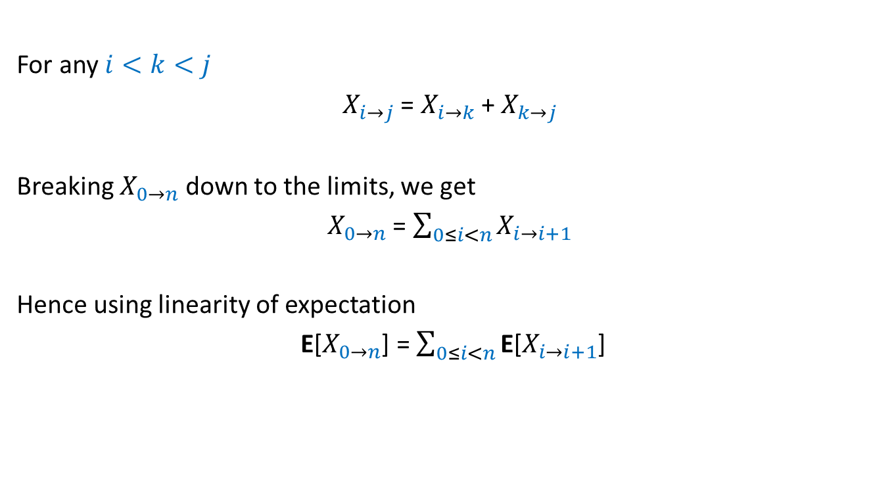


Distributed Client-Server problem Randomized protocol
Lemma1 : After round $i+1$, the expected number of balls left
is less than $\frac{1}{e}$th fraction of the balls after round $i$.
$r_{i}=\frac{X_{i}}{n}$: fraction of balls in the system after round $i$.
Lemma 1 implies E[$r_{i+1}$]$≤ ??$
➔ If everything goes as expected, then
$${\frac{1}{e}E[r}_{i}]$$
Round | No. of balls in the system | Fraction of balls in the system
0 | $$n$$ | 1
1
$$n/e$$
$$1/e$$
2
$$<n/e^{2}$$
$$<1/e^{2}$$
This table gives the intuition for the expected no. of rounds but it directly does not help us to calculate the expected no. of rounds ? It also does not directly help to get a high prob. Bound. Convince yourself before proceeding further.

Slide 17
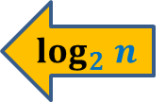

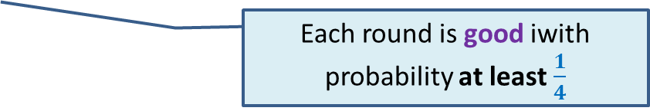



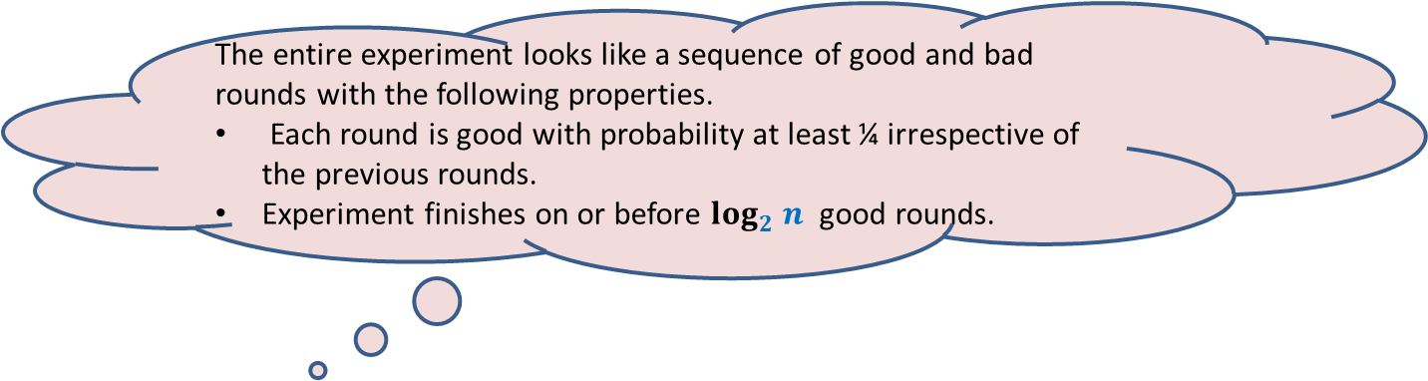
Distributed Client-Server problem Randomized protocol
Lemma1 : After round $i+1$, the expected no. of balls
is less than $\frac{1}{e}$th fraction of the balls after round $i$.
Definition: round $i+1$is good if $r_{i+1}<{\frac{1}{2}r}_{i}$, and bad otherwise.
P(a round is bad) = ??
➔ P(a round is good) $>\frac{1}{4}$
Question: After how many good rounds will there be no ball left ?
Expected no. of rounds = ??
Use Markov’s Inequality
$$≤\frac{2}{e}$$
$$≤\frac{3}{4}$$
$$log_{2} n$$
The entire experiment looks like a sequence of good and bad rounds with the following properties.
Each round is good with probability at least ¼ irrespective of the previous rounds.
Experiment finishes on or before $log_{2} n$ good rounds.
Each round is good iwith probability at least $\frac{1}{4}$
$$≤4 \log_{2}n$$

Slide 18

Distributed Client-Server problem Randomized protocol
Theorem:
The Randomized protocol will terminate in expected O($\log_{2}n$) rounds.
This bound is very loose.
Can you see why ?

Slide 19
An important insight that we missed
Question: What is the cause of multiple rounds for a ball ?
Answer: presence of other competing balls
INSIGHT
As the algorithm proceeds:
The number of these competing balls reduce
but the number of bins remain unchanged
➔
Chances of a ball to leave the system increases as the algorithm proceeds.

Slide 20
Distributed Client-Server problem
NEW insight
1
2
3
4
5
6
7
8
Balls
Bins
1 2 3 4 5 6 7 8

Slide 21
Calculating expected no. of rounds
with NEW insight

Slide 22

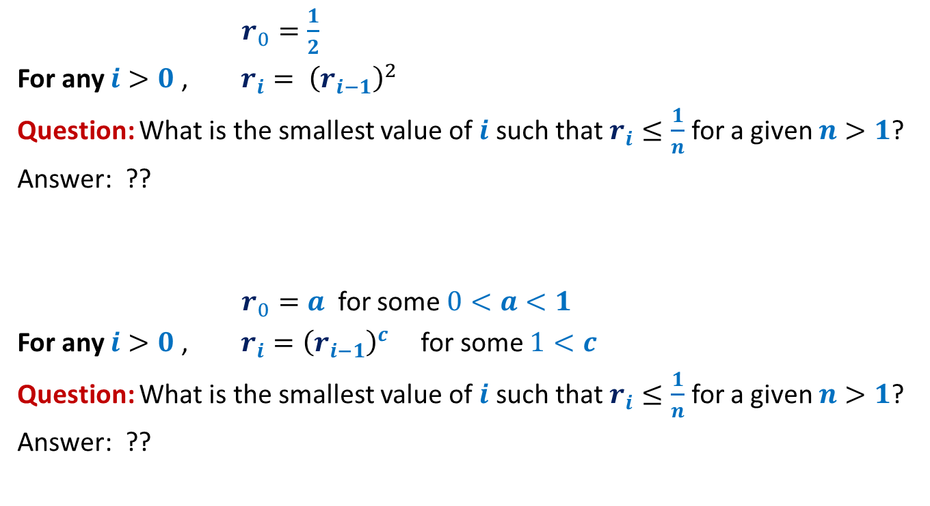

Recurrence 2
$r_{0}=\frac{1}{2}$
For any $i>0$, $r_{i}= {\left(r_{i−1}\right)}^{2}$
Question: What is the smallest value of $i$ such that $r_{i}≤\frac{1}{n}$ for a given $n>1$?
Answer: ??
$r_{0}=a$ for some $0<a<1$
For any $i>0$, $r_{i}={\left(r_{i−1}\right)}^{c}$ for some $1<c$
Question: What is the smallest value of $i$ such that $r_{i}≤\frac{1}{n}$ for a given $n>1$?
Answer: ??
$$\log_{2}log_{2}{n}$$
$$\log_{c}{\log_{1/a}{n}}$$

Slide 23

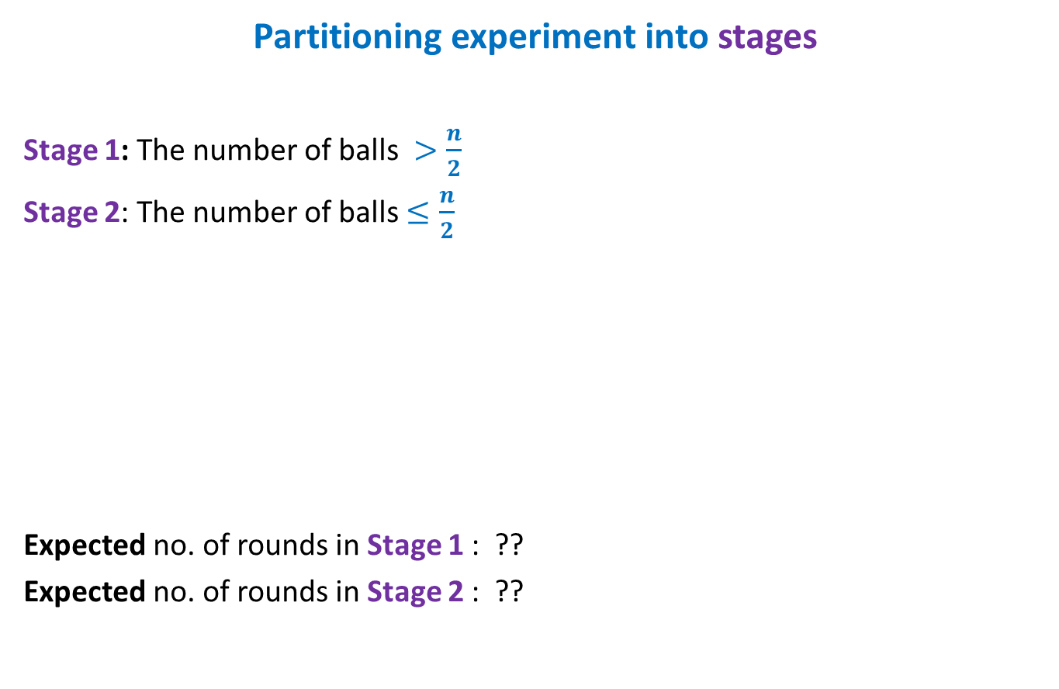

Distributed Client-Server problem Randomized protocol
Partitioning experiment into stages
Stage 1: The number of balls $>\frac{n}{2}$
Stage 2: The number of balls $≤\frac{n}{2}$
Expected no. of rounds in Stage 1 : ??
Expected no. of rounds in Stage 2 : ??
Stage 1
Stage 2
$$no. of balls≤\frac{n}{2}$$
$≤$4

Slide 24
Calculating expected no. of rounds in stage 2

Slide 25



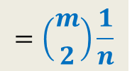

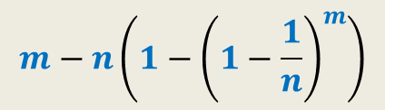
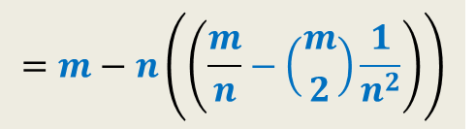

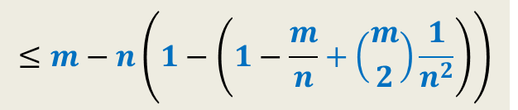

Distributed Client-Server problem Randomized protocol
Round $i+1$
1
2
$$m$$
$X_{i}$: no. of balls at the end of round $i$.
E[$X_{i+1}$| $X_{i}=m$] = ??
1 2 3 … $n$-1 $n$
$$m−n\left(1−{\left(1−\frac{1}{n}\right)}^{m}\right)$$
$$m−expected no. of nonempty bins$$
$$≤m−n\left(1−\left(1−\frac{m}{n}+\left({m \atop 2}\right)\frac{1}{n^{2}}\right)\right)$$
$$=m−n\left(\left(\frac{m}{n}−\left({m \atop 2}\right)\frac{1}{n^{2}}\right)\right)$$
${\left(1−\frac{1}{n}\right)}^{m}$
$=1−\frac{m}{n}+\left({m \atop 2}\right)\frac{1}{n^{2}}−\left({m \atop 3}\right)\frac{1}{n^{3}}+\left({m \atop 4}\right)\frac{1}{n^{4}}…$
$≤1−\frac{m}{n}+\left({m \atop 2}\right)\frac{1}{n^{2}}$
$$=\left({m \atop 2}\right)\frac{1}{n}$$

Slide 26
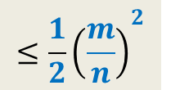
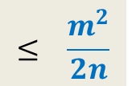
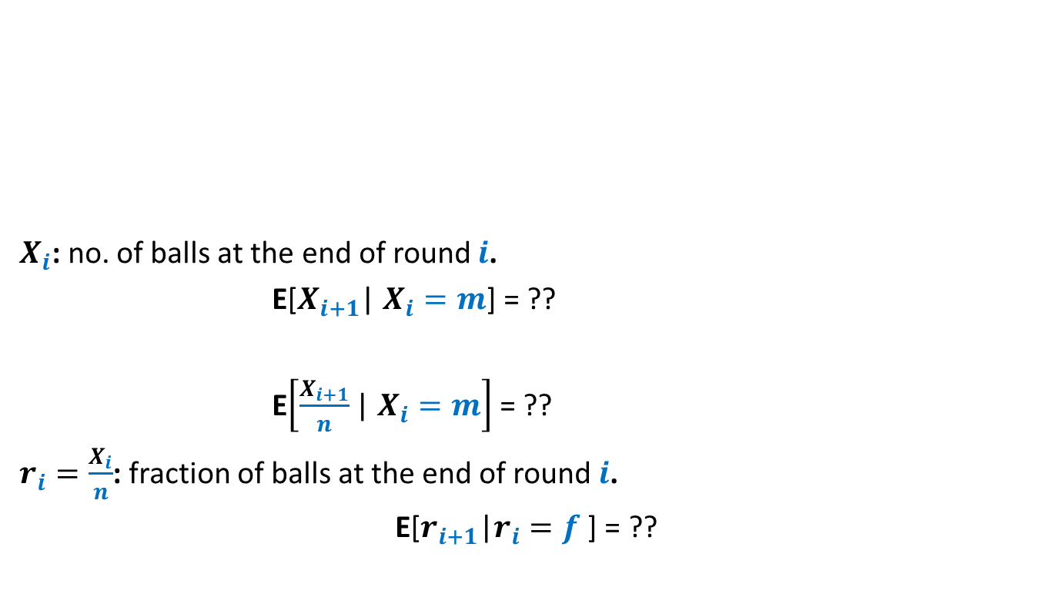
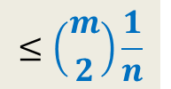
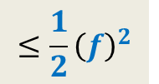
Distributed Client-Server problem Randomized protocol
Round $i+1$
1
2
$$m$$
$X_{i}$: no. of balls at the end of round $i$.
E[$X_{i+1}$| $X_{i}=m$] = ??
E$\left[\frac{X_{i+1}}{n}\text{| }X_{i}=m\right]$ = ??
$r_{i}=\frac{X_{i}}{n}$: fraction of balls at the end of round $i$.
E[$r_{i+1}$|$r_{i}=f$ ] = ??
1 2 3 … $n$-1 $n$
$$≤\left({m \atop 2}\right)\frac{1}{n}$$
$$≤ \frac{m^{2}}{2n}$$
$$≤{\frac{1}{2}\left(\frac{m}{n}\right)}^{2}$$
$$≤{\frac{1}{2}\left(f\right)}^{2}$$

Slide 27

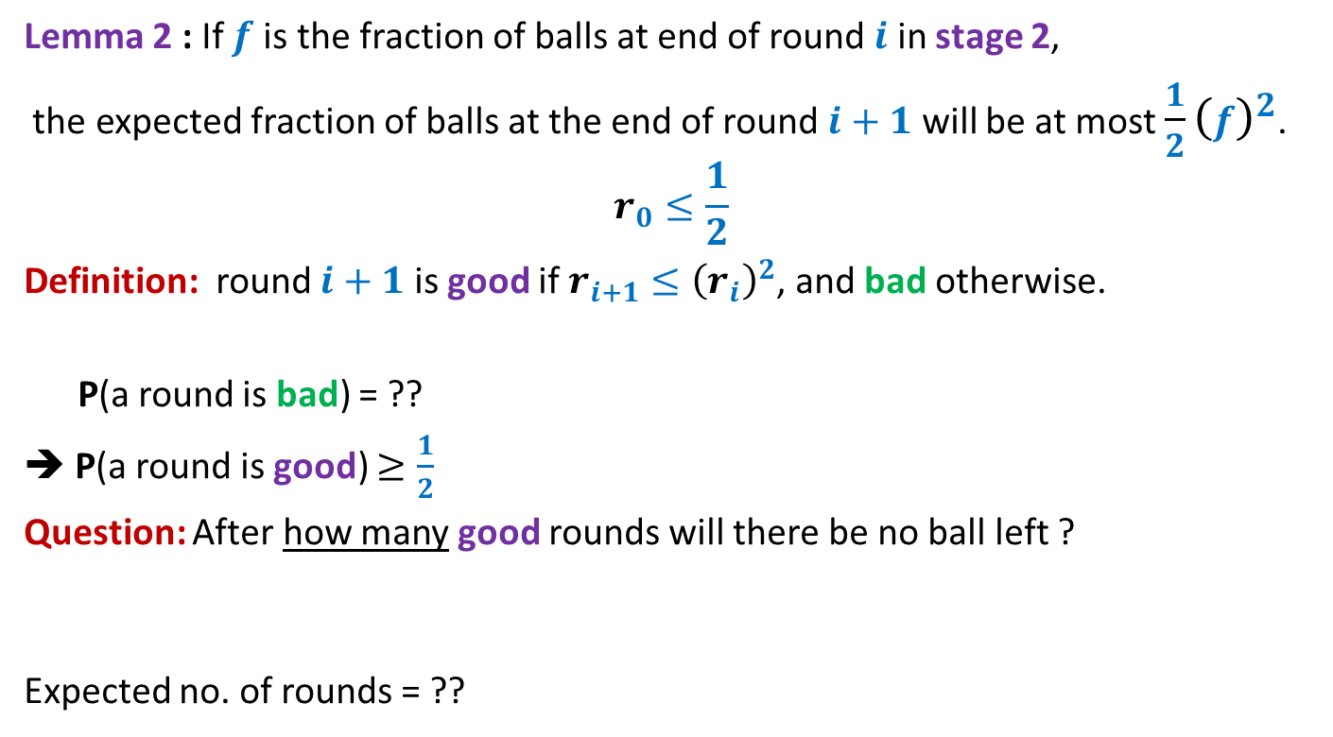

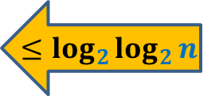
Distributed Client-Server problem Randomized protocol
Lemma 2 : If $f$is the fraction of balls at end of round $i$ in stage 2,
the expected fraction of balls at the end of round $i+1$ will be at most ${\frac{1}{2}\left(f\right)}^{2}$.
$$r_{0}≤\frac{1}{2}$$
Definition: round $i+1$ is good if $r_{i+1}≤{\left(r_{i}\right)}^{2}$, and bad otherwise.
P(a round is bad) = ??
➔ P(a round is good) $≥\frac{1}{2}$
Question: After how many good rounds will there be no ball left ?
Expected no. of rounds = ??
Use Markov’s Inequality
$<\frac{1}{2}$
$$≤\log_{2}{\log_{2}{n}}$$
$$≤2\log_{2}{\log_{2}{n}}$$

Slide 28

Distributed Client-Server problem Randomized protocol
Theorem: The expected number of rounds taken by the Randomized protocol
is at most $4+2\log_{2}{\log_{2}{n}}$.

Slide 29
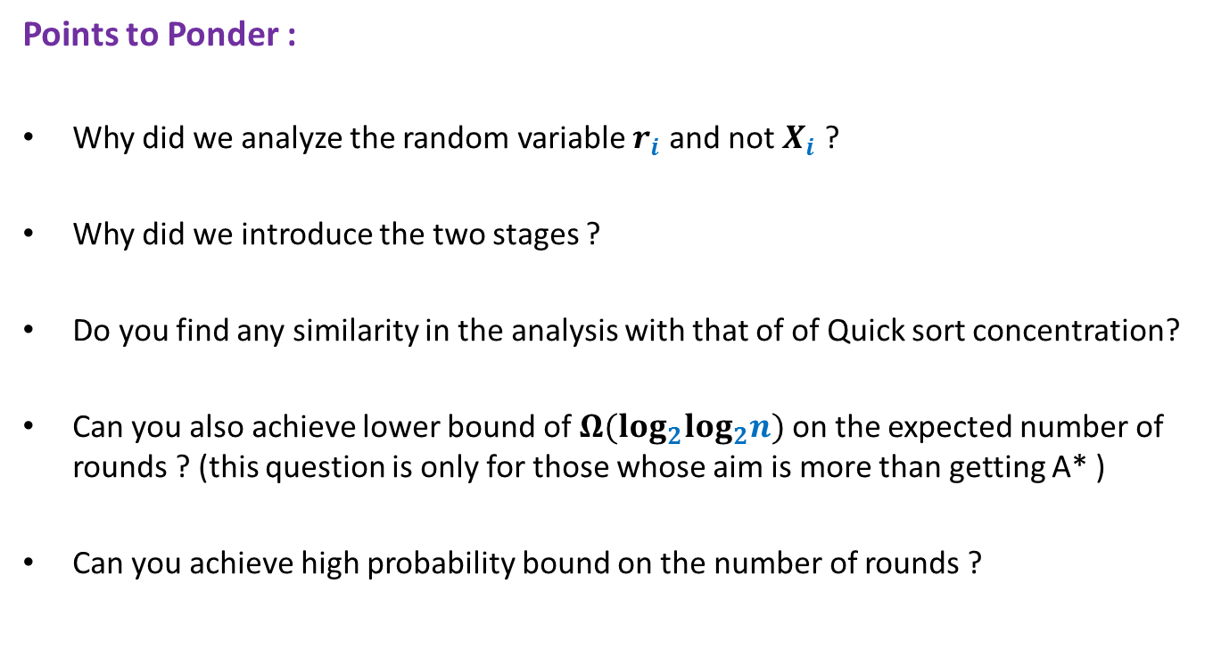
Distributed Client-Server problem Randomized protocol
Points to Ponder :
Why did we analyze the random variable $r_{i}$ and not $X_{i}$ ?
Why did we introduce the two stages ?
Do you find any similarity in the analysis with that of of Quick sort concentration?
Can you also achieve lower bound of $Ω(log_{2}log_{2}n)$ on the expected number of rounds ? (this question is only for those whose aim is more than getting A* )
Can you achieve high probability bound on the number of rounds ?

Slide 30
Rumor spreading

Slide 31
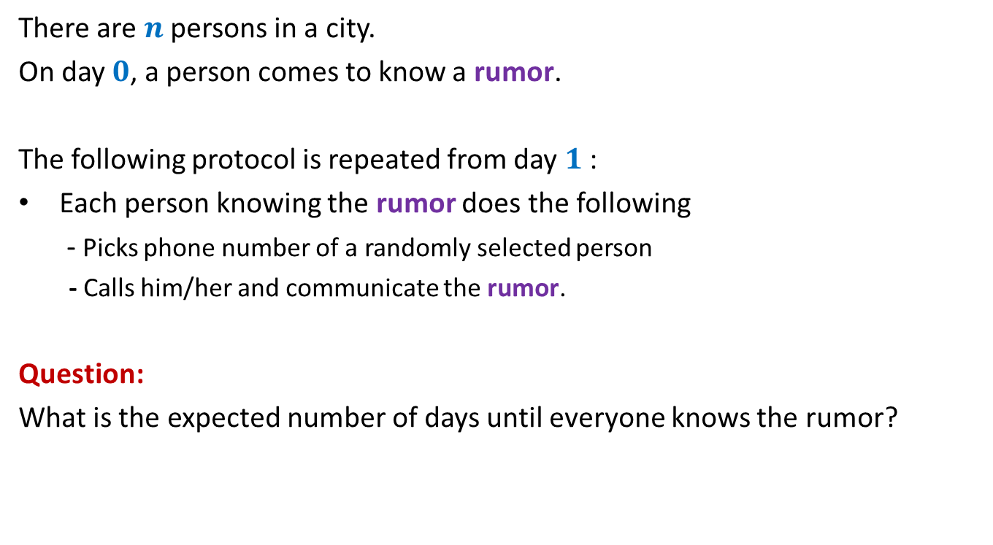
Rumor Spreading
There are $n$ persons in a city.
On day $0$, a person comes to know a rumor.
The following protocol is repeated from day $1$:
Each person knowing the rumor does the following
- Picks phone number of a randomly selected person
- Calls him/her and communicate the rumor.
Question:
What is the expected number of days until everyone knows the rumor?

Slide 32

Rumor Spreading
Question:
What is the minimum number of days until everyone knows the rumor?
Answer: $log_{2}n$
Number of people knowing the rumor can only double in a day.

Slide 33

Rumor Spreading
Theorem :
The entire city comes to know the rumor in O($log_{2}n$) expected days.
With a lot of hints, this will be a problem in the next assignment.
With high probability as well.

Slide 34
Problems for next lecture

Slide 35
Max. load is O(log $n$/loglog $n$) with high probability. (proved in some lecture)
Problem1:
To show that Max. load is $Ω$(log $n$/loglog $n$) with probability $>c$.
Problem2:
$X:$ the number of empty bins
Concentration of $X$ around $E[X]$ ?
1
2
3
4
5
6
7
8
Balls
Bins
1 2 3 4 5 6 7 8

Slide 36
Approximate Distance oracles

Slide 37
All-Pairs Shortest Paths
Notations and Terminologies :
A graph $G=(V,E)$ on
$n=|V|$ vertices
$m=|E|$ edges
$ω:E→R^{+}$
A path from $u$to $v$: a sequence ${(u=)x}_{0}$, $x_{1}$,…, $x_{k}(=v)$ where ($x_{i}$,$x_{i+1}$) $∈E$
Length of a path $P$ : sum of the weights on the edges of path $P$.
Shortest path from $u$to $v$ : the path of smallest length from $u$to $v$.
Distance from $u$to $v$ : the length of the shortest path from $u$to $v$.
$δ(u,v)$ : Distance from $u$to $v$

Slide 38
All-Pairs Shortest Paths
Problem Definition: Given a graph $G=(V,E)$, build a compact data structure
so that for any $u,v∈V$,
$δ(u,v)$ can be reported in $O(1)$ time
Shortest path from $u$ to $v$ can be reported in optimal time.
Results known:
$O(n^{2})$ size data structure
(Distance matrix and Witness matrix)
$O(mn+n^{2}log n)$ preprocessing time
(Dijkstra’s algorithm from each vertex)
Current-state-of-the-art RAM size: 8 GBs
➔Can’t handle graphs with even ${10}^{5}$ vertices (with RAM size) ☹

Slide 39
All-Pairs Approximate Shortest Paths
Problem Definition: Given a graph $G=(V,E)$, build a compact data structure
so that for any $u,v∈V$, it reports $\hat{δ}(u,v)$ in $O(1)$ time satisfying
$$δ\left(u,v\right)≤\hat{δ}(u,v)≤t δ(u,v)$$
$t$: stretch.
Aim: To achieve
Sub-quadratic space.
Sub-cubic preprocessing time.
With $O(1)$ query time.
Many elegant results have been invented for undirected graphs ☺

Slide 40
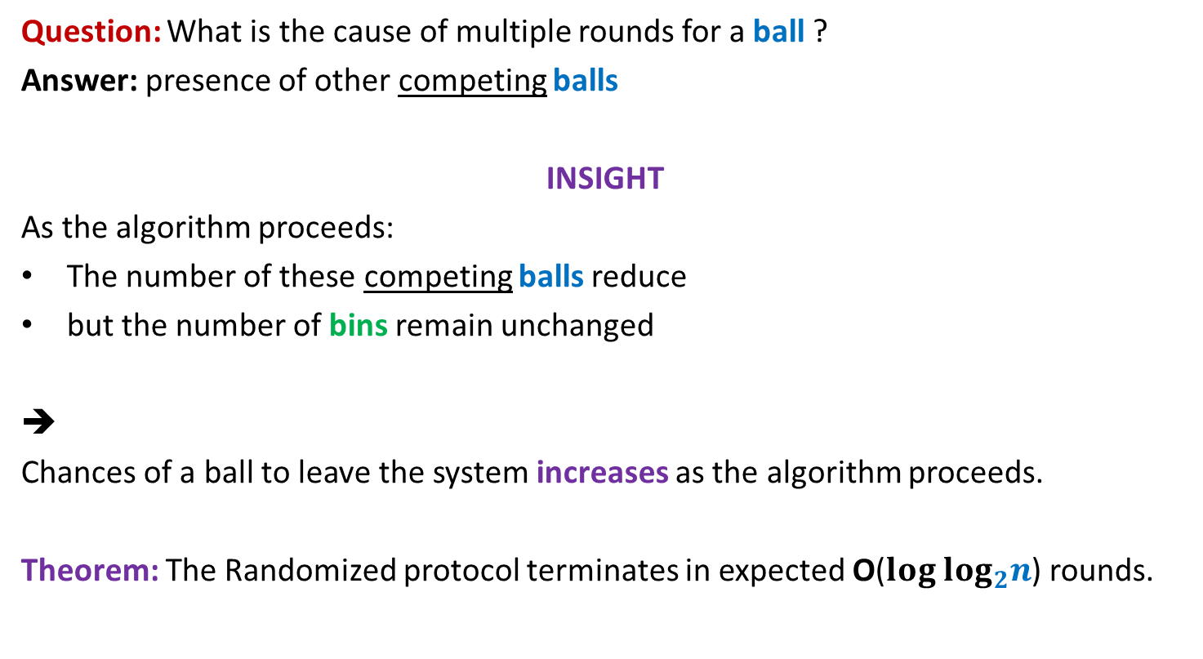
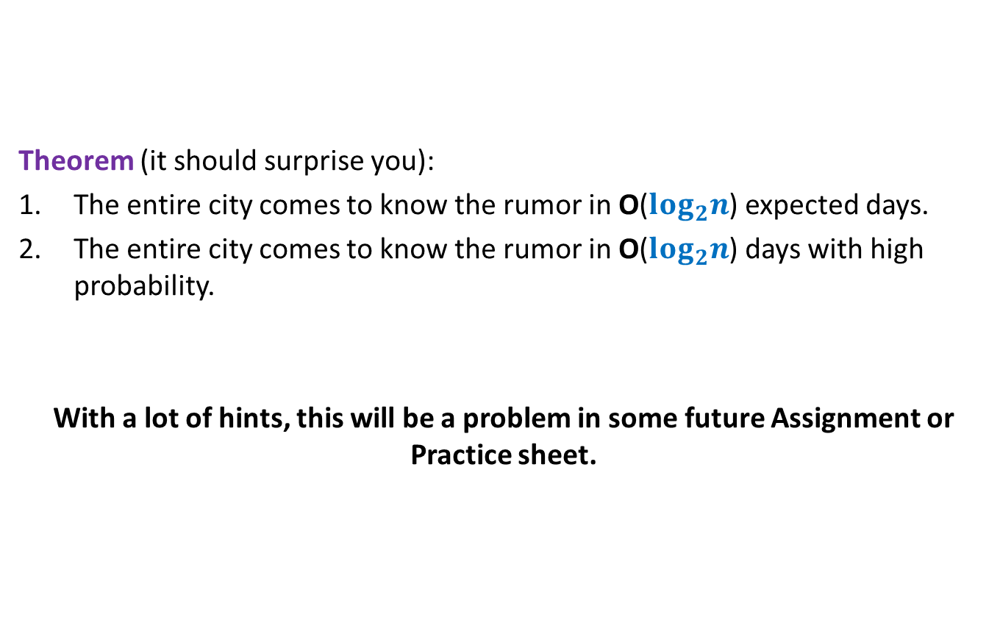
A truly magical result
Approximate Distance Oracles
$t$:Stretch | Space | Query time | Preprocessing time
$$3$$
$$O(n^{1+\frac{1}{2}})$$
$$O(1)$$
$$O({mn}^{\frac{1}{2}})$$
$$5$$
$$O(n^{1+\frac{1}{3}})$$
$$O(1)$$
$$O({mn}^{\frac{1}{3}})$$
$$2k−1$$
$$O(n^{1+\frac{1}{k}})$$
$$O(k)$$
$$O({k mn}^{\frac{1}{k}})$$
Mikkel Thorup and Uri Zwick:
Approximate Distance Oracles for graphs,
Journal of ACM (4), 2005

Slide 41
Inspiration from our daily life

Slide 42
Air/Road Network
$$Lucknow$$
$$Delhi$$
$$Kanpur$$
$$Bangalore$$

